Slide 1

Gulp.JS
The Simple Build Tool Using Node.JS

Slide 2
Requirements
Node.JS
NPM (Node Package Manager)
(Packaged with Node.JS By Default)
Install

Slide 3
How Gulp Works
Converts your code into a Stream of bytes
Passes it to plugins you want
Plugins change the code how you want

Slide 4
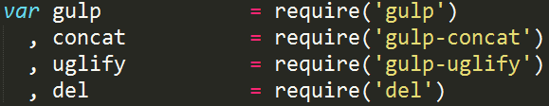
How to use Gulp
Configuration written in JavaScript in a file named “gulpfile.js”
Plugins are modules obtained through node's “require” method

Slide 5
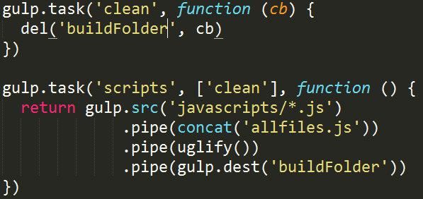
Code is divided into “tasks”
Tasks are asynchronous and either require something to be returned or for task to pass a callback
Tasks can require other tasks to be run and complete before they will run using ['taskname']

Slide 6
Running Gulp & Watching
Gulp is run by calling the 'gulp' command followed by the task name
Or having a task called 'default' and then you can call just 'gulp'

Slide 7
Gulp Plugins

Slide 8
Concatenation & Ugilify
Concatenation
  Combining all your code into a single file
Ugilify
  Reduce the file size of your code
  Removing whitespace, reducing variable names etc

Slide 9
Examples:
Jquery
  197kB across 81 files
  After concatentation & Ugilify: 82.3kB
  59% file size decrease*
Angular
  3.10 mB across 863 files.
  After concatentation & Ugilify: 122kB
  96% file size decrease*
* Comparing 'src' folder in respective github to minified version.

